Slide 1
CODING DECODING
Û
Æ
þ
Ø
SHABANA

Slide 2
DEFINITION
A CODE is a ‘system of signals’. Therefore, Coding is a method of
transmitting a message between the sender and the receiver
without a third person knowing it.
The Coding and Decoding Test is set up to judge the candidate’s
ability to decipher the rule that codes a particular word OR
message with different logics and break the code to decipher the
message.

Slide 3
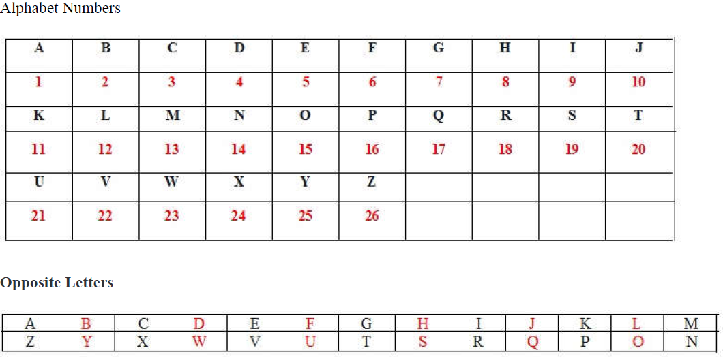
QUESTION - TYPES
Problems in this section consist of a coded word followed by a question. You have to find the
logic used in that code and apply the same logic to the given word.

Slide 4
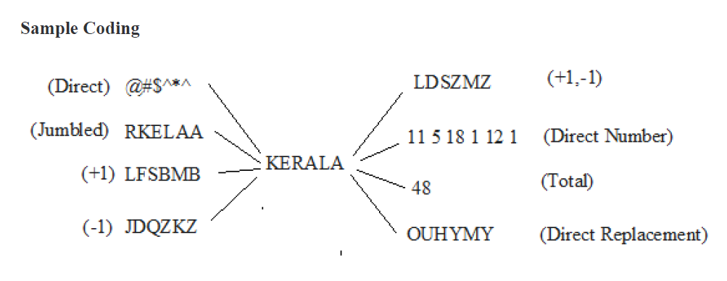
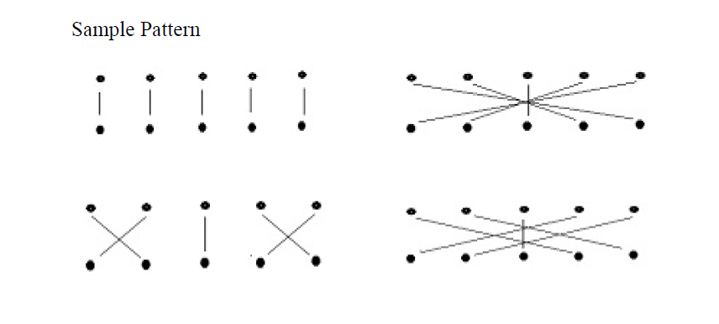
QUESTION - TYPES

Slide 5
DECODE THE FOLLOWING
If CANDY is coded as ACNYD, how will SWEET be coded in that
language?
A. SETEW
B. WTEES
C. WSETE
D. NOTA
1

Slide 6
DECODE THE FOLLOWING
In a certain code, UNIVERSITY is written as VOJWFSTJUZ. How is
COLLEGE written in that code?
A. DPMMFHF
B. DFMMHPF
C. FDMMHPF
D. NOTA
2

Slide 7
DECODE THE FOLLOWING
In a certain code, WINTER is written as YKPVGT. How is
SUMMER written in that code?
A. UOOWTG
B. WUOOTG
C. UWOOGT
D. NOTA
3

Slide 8
DECODE THE FOLLOWING
In a certain code, FACEBOOK is written as CXZBYLLH. How is
TWITTER written in that code?
A. TQFTTOB
B. QTFQQBO
C. QTQFQBO
D. NOTA
4

Slide 9
DECODE THE FOLLOWING
In a certain code, PLEASANT is written as QNHEXGUB. How is
COMFORT written in that code?
A. DTPQJXA
B. DPQTJAX
C. DQPJTXA
D. NOTA
5

Slide 10
DECODE THE FOLLOWING
In a certain code, LAPTOP is written as PBSYVL. How is
MOBILE written in that code?
A. EPENSM
B. EEPNSM
C. EPENMS
D. NOTA
6

Slide 11
DECODE THE FOLLOWING
In a certain code, LIFESTYLE is written as ELIYFTESL, PANTALOONS
is written as SNAONOTLAP. How is RELIANCE written in that code?
A. ECENLAIR
B. EELNCAIR
C. ECNELAIR
D. NOTA
7

Slide 12
DECODE THE FOLLOWING
In a certain code, REMOTE is written as JEZONE. How is TIGER
written in that code?
A. NINJE
B. NNIEJ
C. NINEJ
D. NOTA
8

Slide 13
DECODE THE FOLLOWING
In a certain code, ACCENTURE is written as DIGTSVADL. How is
COGNIZANT written in that code?
A. FKDSNZGFA
B. FSKDNZGFA
C. SKDNZGFAF
D. NOTA
9

Slide 14
DECODE THE FOLLOWING
In a certain code language ‘EDUCATED’ is written as
‘DVEFEFUB’ and ‘DAUGHTER’ is written as ‘HVBESFUI’. How is
‘VICTORIA’ written in that language ?
A. UJDWBJSP
B. UDJWBJSP
C. BJSPUDJW D. NOTA
10

Slide 15
DECODE THE FOLLOWING
According to a coding scheme the sentence:
“Peacock is designated as the national bird of India” is coded as
5688999 35 1135556678 56 458 13666689 1334 79 13366...
This coding scheme has the following rules:
a: The scheme is case-insensitive (does not distinguish between upper case
and lower case letters).
b: Each letter has a unique code which is a single digit from among 1,2,3, …,9.
c: The digit 9 codes two letters, and every other digit codes three letters....
d: The code for a word is constructed by arranging the digits corresponding to its letters in a non-decreasing sequence.

Slide 16
DECODE THE FOLLOWING
What best can be concluded about the code for the letter I?
a) 1
b) 3
c) 1 or 3
d) 6
11

Slide 17
DECODE THE FOLLOWING
What best can be concluded about the code for the letter B?
a) 3 or 4
b) 1 or 3 or 4
c) 1
d) 3
12

Slide 18
DECODE THE FOLLOWING
What best can be concluded about the code for the letter L?
a) 3 or 4
b) 1 or 3 or 4
c) 1
d) 3
13

Slide 19
DECODE THE FOLLOWING
What best can be concluded about the code for the letter S?
1
2
3
4
NOTA
14

Slide 20
DECODE THE FOLLOWING
In a code language,
start walk stop diet is coded as 8% #21 3$7 *6
walk rest start bite is coded as #9 *6 2@9 #21
stop work diet rest is coded as ^78 8% 3$7 #9
bite rest start diet is coded as 2@9 #9 *6 3$7
Find the code for 'work diet'?
A. 3$7 #9
B. ^78 3$7
C. ^78 #9
D. 3$7 *6
15

Slide 21
DECODE THE FOLLOWING
If BZSQUSJHDB stands for ARTIC, PNDBFDBZOM stands for OCEAN, in the same manner JHOMECJHBZ will stand for
A. DAINE
B. NEDIA
C. INDIA
D. IDANE
E. NOTA
16

Slide 22
DECODE THE FOLLOWING
In a certain code language, if BUG=90 and ALMS=180 then
CADET=?
a. 153
b. 165
c. 175
d. 148
e. 185
17

Slide 23
DECODE THE FOLLOWING
In a certain code, RIPPLE is written as 613382 and LIFE is
written as 8192. How is PILLER written in that code?
A. 318826
B. 318286
C. 618826
D. 338816
18

Slide 24
DECODE THE FOLLOWING
If orange is called butter, butter is called soap, soap is called
ink, ink is called honey and honey is called orange, which of
the following is used for washing clothes?
A. Honey
B. Butter
C. Orange
D. Soap
E. Ink
19

Slide 25
DECODE THE FOLLOWING
If the animals which can walk are called swimmers, animals
who crawl are called flying, those living in water are called
snakes and those which fly in the sky are called hunters, then
what will a lizard be called?
A. Swimmers
B. Snakes
C. Flying
D. Hunters
E. None of these
20

Slide 26
DECODE THE FOLLOWING
In a certain code language,
'col tip mot' means 'singing is appreciable' ;
'mot baj min' means 'dancing is good' and
'tip nop baj' means 'singing and dancing' ,
which of the following means 'good' in that code language ?
A. not
B. Min
C. Baj
D. CBD
E. None of these
21

Slide 27
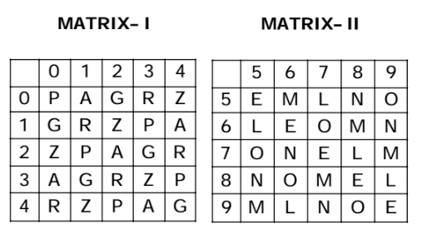
DECODE THE FOLLOWING
A word is represented by only one set of numbers as given in any one of the alternatives. The sets of numbers given in the alternatives are represented by two classes of alphabets as in two matrics given below. The columns and rows of Matrix I are numbered from 0 to 4 and that of Matrix II
are numbered from 5 to 9 A letter from these matrices can be represented first by its row and next by its column, e.g. ‘A’ can be represented by 01, 14 etc. and ‘M’ can be represented by 56, 68 etc. Similarly, you have to identify the set for the word ‘EAGLE’.
10. 67, 34, 14, 23
44, 98, 42, 78, 30
C. 23, 67, 34, 14, 78
D. 44, 22, 31, 89, 76
22

Slide 28
DECODE THE FOLLOWING
In a certain code language, (A) ‘pit dar na’ means ‘you are good’ (B) ‘dar tok pa’ means ‘good and bad’ (C) ‘tim na tok’ means 'they are bad’ In that language, which word stands for 'they' ?
A. Na
B. Tok
C. Tim
D. Pit
23

Slide 29
DECODE THE FOLLOWING
If 'black' means 'pink', 'pink' means 'blue', 'blue' means 'white', 'white' means 'yellow', 'yellow' means 'red' and 'red' means 'brown', then what is the colour of clear sky ?
A. Brown
B. Red
C. Blue
D. Pink
E. None of these
24

Slide 30
DECODE THE FOLLOWING
If the word ‘EXAMINATION’ is coded as 56149512965, then the word ‘GOVERNMENT’ is coded as:...
A. 7645954552
B. 7654694562
C. 7645965426
D. 7654964526
25

Slide 31
CODING DECODING - KEY
1 | 2 | 3 | 4 | 5
C | A | C | B | C
6 | 7 | 8 | 9 | 10
A | A | C | B | B
11 | 12 | 13 | 14 | 15
B | A | C | B | B
16 | 17 | 18 | 19 | 20
C | B | A | E | C
21 | 22 | 23 | 24 | 25
B | C | C | E | A

